Slide 1

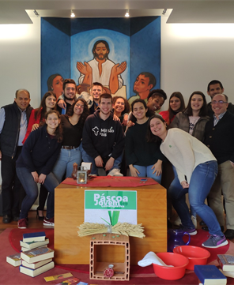
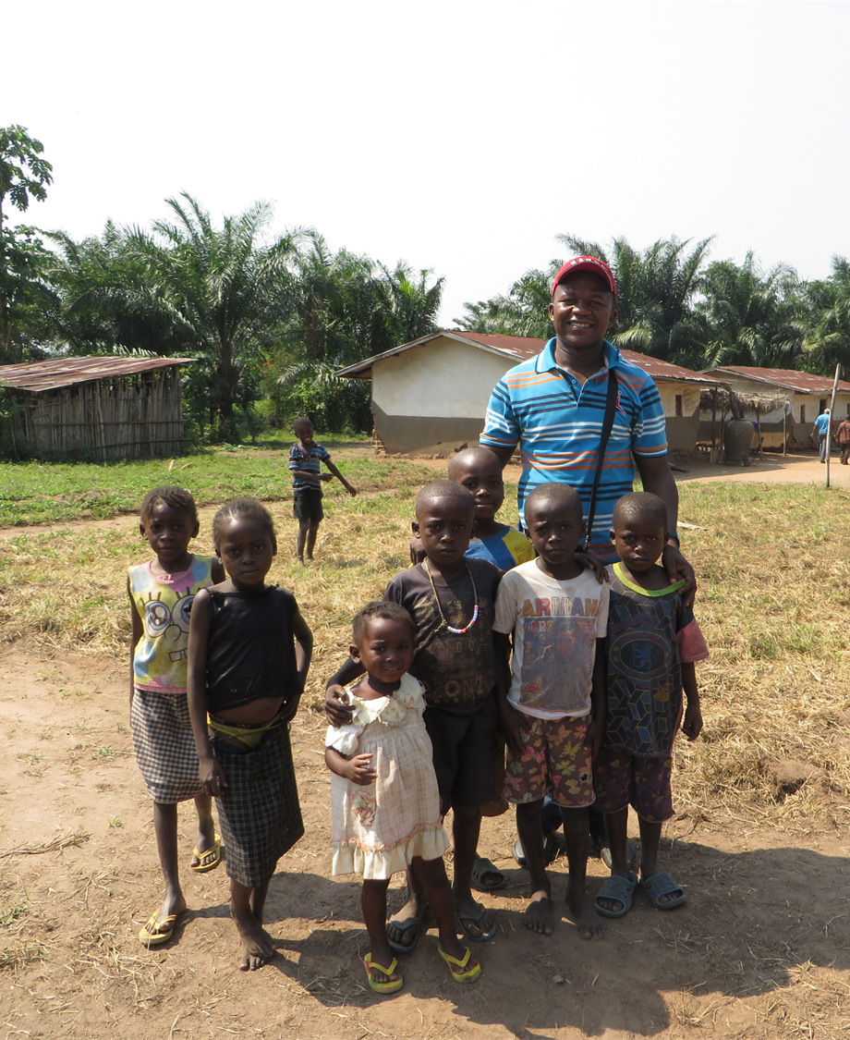
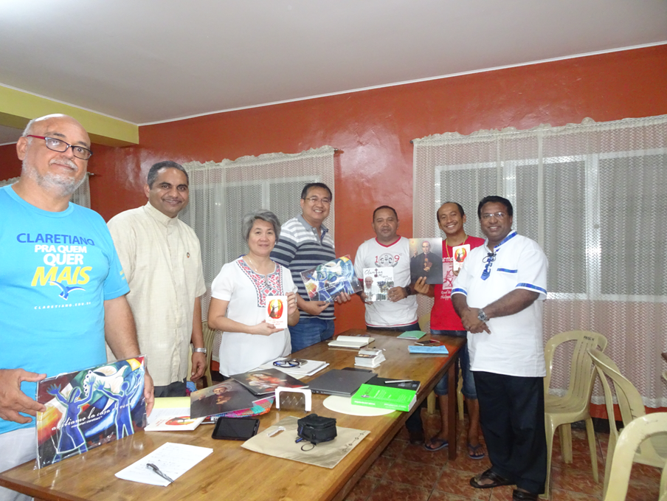

Slide 2
FOUR Knowledge areas of general Mission procure
Functioning
Mission Procure
Project Format & CLAPNET
Claretian Mission Day
Policies for Project Work

Slide 3

PROJECT FORMAT
Claretian Mission Day
SESSION : 4, MICLA Training

Slide 4
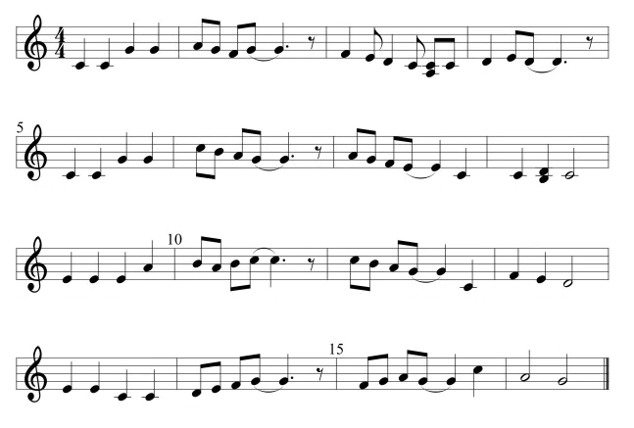
WHY A COMMON FORMAT
Orderly way of presenting all the needed information for decision making
Purpose – To be accepted by the General Mission Procure Council
Same format for Pastoral and Social Projects
Previous Situation – Different kinds of proposals – difficult for decision making because some important components missing
Simple Format even beginners can fill in

Slide 5
Parts of the Common Project Format
Title Page
Project Information
Financial Information
Annexure
Declaration
Title Page
Project Information
Financial Information
Declaration
Annexure

Slide 6
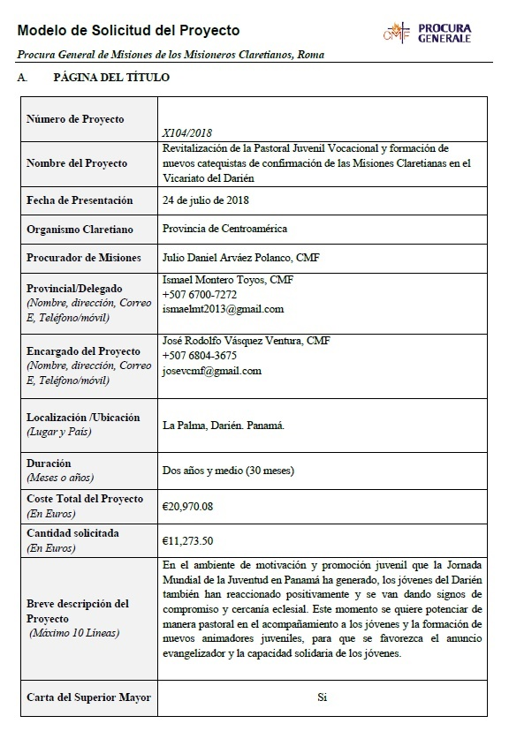
A. Title Page
Basic Project Information at one glace
Correct Details
Complete information
Brief Description of Project – Used for CLAPNET

Slide 7
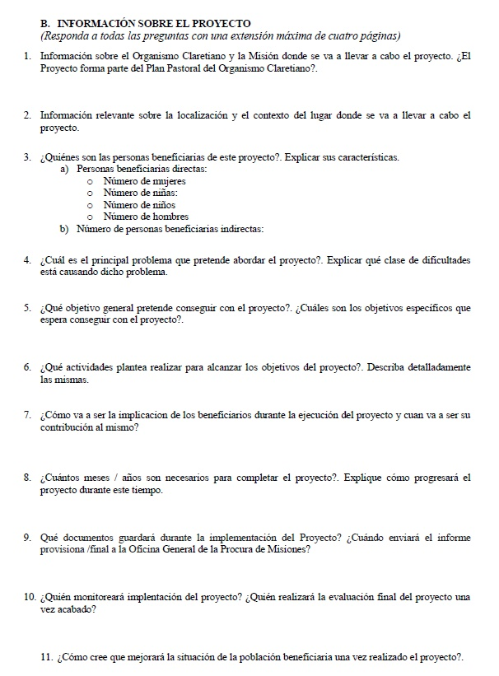
Project Information
Organism
Location
Beneficiaries , their participation
Main problem dealt in the project
Explanation of Solution
  Goal - 1
  Objective - Few
  Activities – Many
Duration
Documentation and Reporting
Monitoring
Sustainability

Slide 8

C. Finance Plan
Cost Plan
Finance Plan
Banking Information

Slide 9
Cost Plan
In order to know how much it will cost for the whole Project
Each Cost is called a Budget Line Item
Recurring Cost and Capital Costs
All costs in local currency
Conversion Rate – www.xe.com
General Procure need all costs in Euro

Slide 10
Finance Plan
Source of Funds
Local Contribution – 10 to 15 % of the total cost
Beneficiaries should contribute . Never give anything free.
All amount in Euro
Requested Amount / number of Beneficiaries = Cost per Beneficiary Ratio

Slide 11
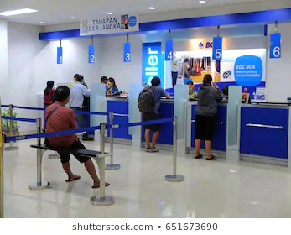
Banking Information
Bank with International Transaction possibility
SWIFT Number is needed
Intermediary Bank
Bank that gives better conversion rate
Good relationship with the Bank Manager
Able to give confirmation of receipt
Online Banking Facilities

Slide 12

D. Declaration
You cannot submit the same project to two funding agencies at the same time.
No emergency, give yourself enough time
Part funding is allowed but informed to both or more agencies
Once discovered , your organization will be blacklisted for 3 years.
General Procure has found some cases

Slide 13
E. Annexure – Supporting Documents
Depending on the nature of the project, you need to submit any of the following documents.
Recommendation letter of Provincial
Recommendation letter of Provincial
Letter from the president of the society/foundation/organization.
Land documents.
Building plans.
Land Value document by the licensed surveyor.
Memorandum of Association/ Statues/ Rules
Copy of registration certificate.
Balance sheet of the society for 3 years ( audited statements)
Agreements between beneficiaries and the organization.
Letter from the beneficiaries.
Photos and videos

