Slide 1
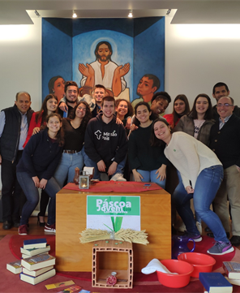
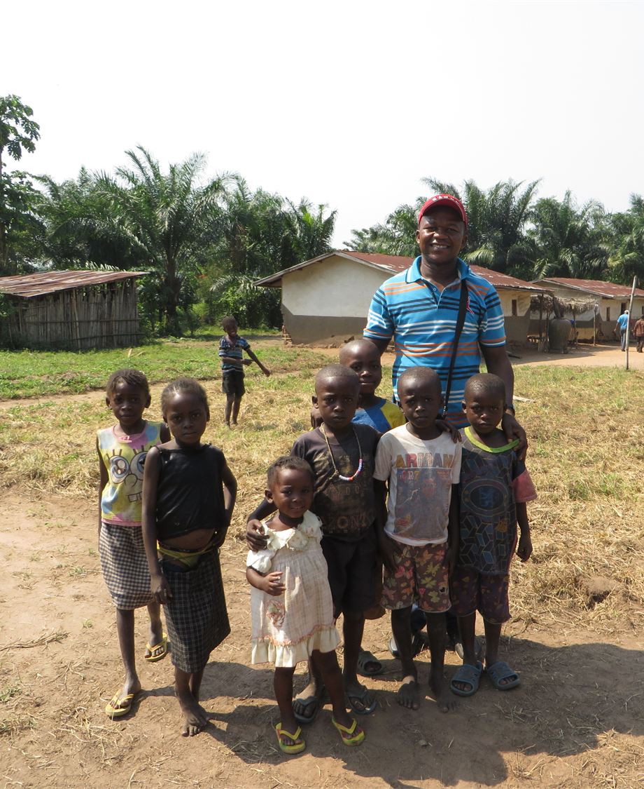
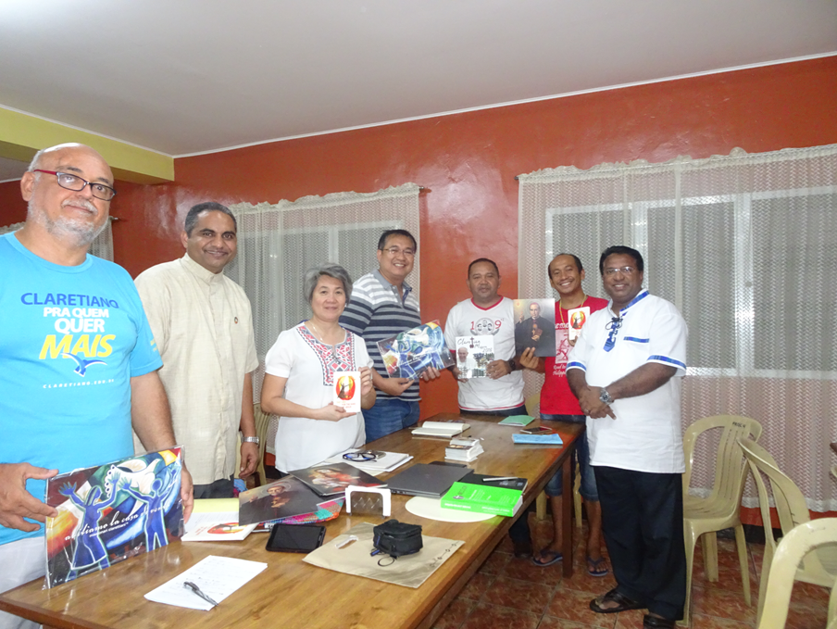

Slide 2
FOUR Knowledge areas of general Mission procure
Functioning
Mission Procure
Project Format & CLAPNET
Claretian Mission Day
Policies for Project Work

Slide 3
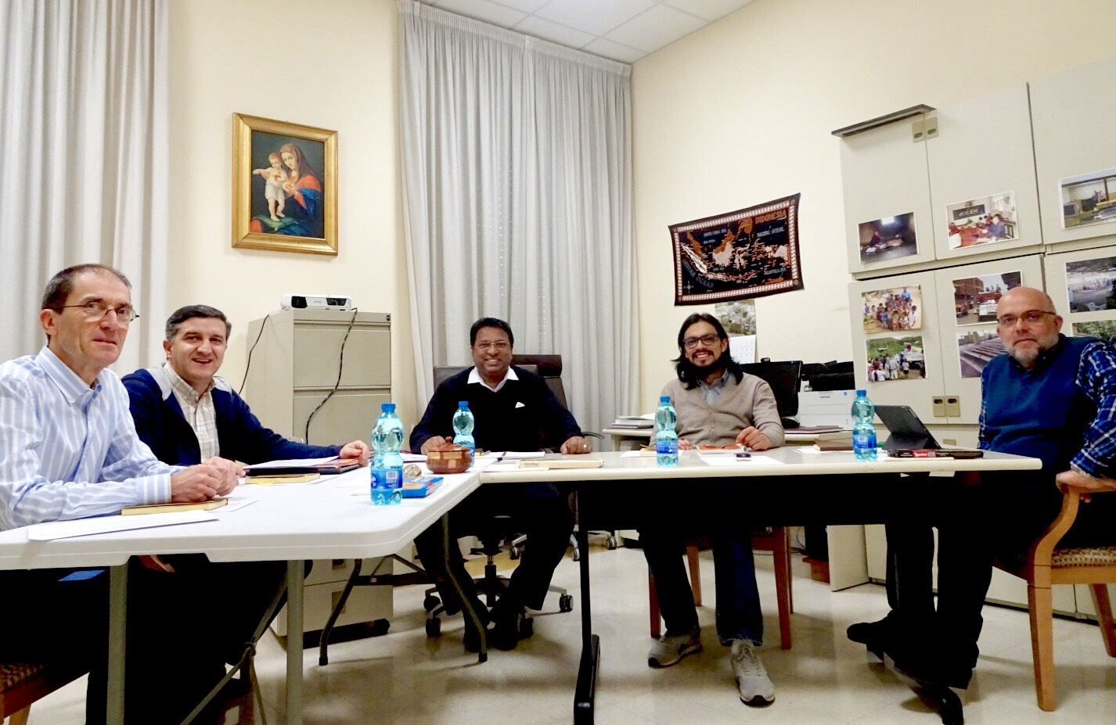
Session 1. FUNCTION OF General Mission Procure
micla Training

Slide 4
Dimensions of Claretian Apostolate
CLARETIAN APOSTOLATE
COMMUNITY
ORGANISM
INDIVIDUALS
1. Missionary Evangelization
2. Personal Testimony
3. Social Development

Slide 5
Function of mission ProcurE (Directory No.123)
To raise mission consciousness and a sense of availability among all the members of the Province;
To promote prayers for missions and to provide up-to-date information concerning their plans, problems and achievements;
To animate Christian communities for missions and promote participation of lay missionaries, especially those born and raised in the mission region, in our work; also, to serve as a liaison between the missions and communities that are preparing lay persons for assignments in mission territories.
To promote financial assistance by creating funds and by presenting projects in the name of the Congregation and other institutions.
To be in a close relationship and coordination with the Secretariat of Justice, Peace and the Integrity of Creation.

Slide 6
1. To raise mission consciousness and a sense of availability among all the members of the Province
1. Missionary Evangelization
2. Personal Testimony
3. Social Development
Clarity about Claretian Mission
Primary Mission of Claretian Missionaries :
Proclamation of the Gospel in three ways
Universal nature of Claretian Mission

Slide 7
2. To promote prayers for missions and to provide up-to-date information concerning their plans, problems and achievements;
Former Relationships
Colonial Connections
Present Relationships
Universal Mission
Prayer support for the Missionaries
Missionary Database
Statistics
Digital Storage of Audio-visuals
Publications
Issue based Documentation

Slide 8
3. To animate Christian communities for missions and promote participation of lay missionaries, especially those born and raised in the mission region, in our work; also, to serve as a liaison between the missions and communities that are preparing lay persons for assignments in mission territories.
Sending Organisms
Formation
Contracts
Receiving Organisms
Induction
Terms and Conditions
Global Claretian Volunteer Program

Slide 9
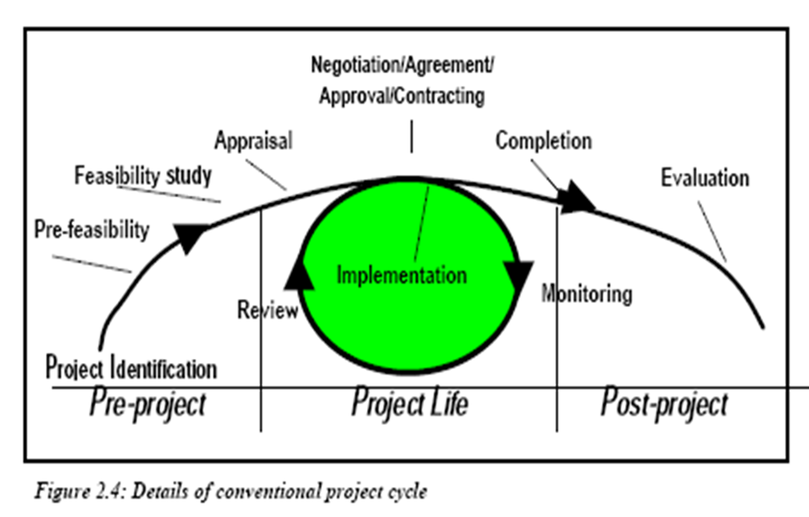
4. To promote financial assistance by creating funds and by presenting projects in the name of the Congregation and other institutions.
Fundraising organ for the Claretian Apostolate
Use various means for Fundraising , Projects are the prominent means.
Guided by the Policies for Project Management of the Congregation
Organisms can create their own Policies
Mission Procure Council in General and Provincial Levels
CLAPNET – Digital platform for managing Claretian projects by the General Procure

Slide 10
5. To be in a close relationship and coordination with the Secretariat of Justice, Peace and the Integrity of Creation.
JPIC
CMF @ UN
Mission Procure
Claretian Apostolate (Spiritual and Social)

Slide 11
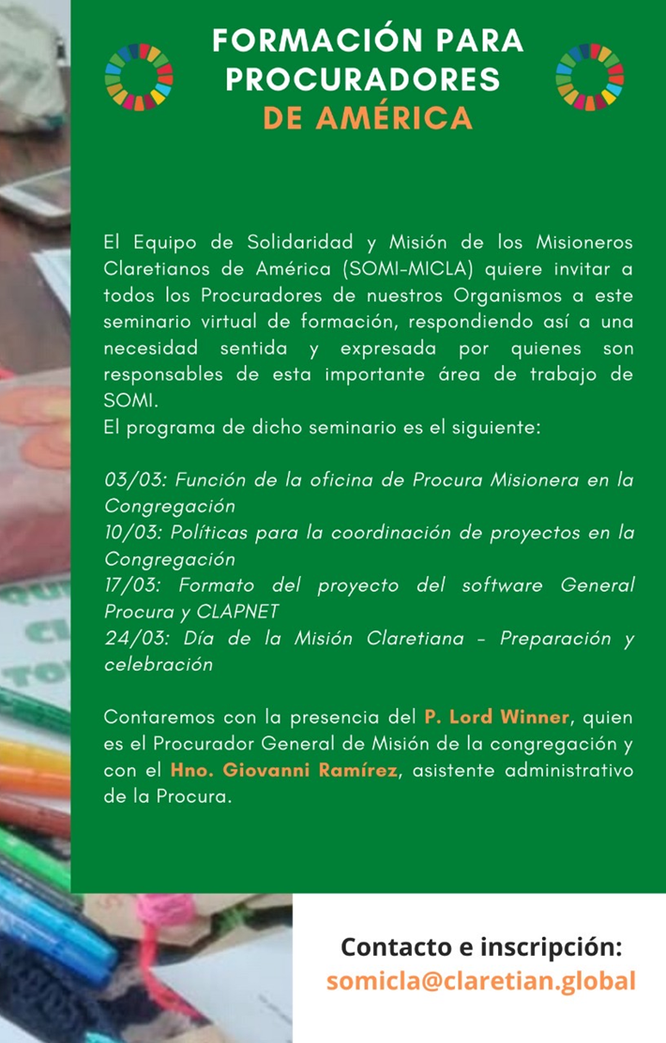
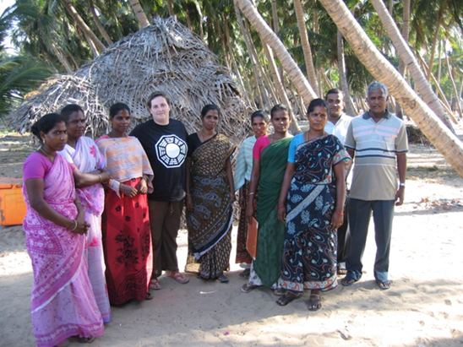
Session 2 – policies for project management 10th march 2020
Thank you

